Slide 1
…
So I could talk about:
The Academy

Slide 2
…
So I could talk about:
The Academy
Friday Training

Slide 3
…
So I could talk about:
The Academy
Friday Training
Big Sis/Bro Scheme

Slide 4
…
AWS Certification roadmap Favouring group based deployments
Growing Best Practice
Building Excellence via Eze
Good Security is Good Software
CI Testing pipelines Azure and GCP training
…

Slide 5
…
Or…
lets talk about bugs

Slide 6


Kickoff Talk
“Bug Hunting 101”
Anthony McKale
Principal Engineer
20/05/2022

Slide 7
Table of Contents
FOR INTERNAL USE ONLY
Types of Bugs
When Bugs Occur
Bug Physiology
Bug Finder Warning: Audience Participation!
Information classiﬁcation: Public

Slide 8
6 Types of Bug
FOR INTERNAL USE ONLY
Compilation Bugs
Runtime Bugs
Logic Bugs
Racetime Bugs
Integration Bugs
Requirements Bugs
Information classiﬁcation: Public

Slide 9
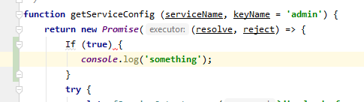
Bug Types: Compilation Bugs*
FOR INTERNAL USE ONLY
These are linting and syntax errors
- Should be caught by code review and unit testing
- Shouldn’t happen on prod * but can if dev/test/prod have different interpreter or library version
* In interpreted languages I mean linting/syntax
Information classiﬁcation: Public

Slide 10
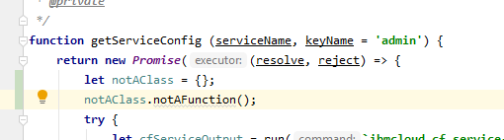
Bug Types: Runtime Bugs
FOR INTERNAL USE ONLY
These are Errors that occur at runtime
- Should be caught by code review and unit testing
- Can happen on production but should be caught and reported in alerting
Information classiﬁcation: Public

Slide 11
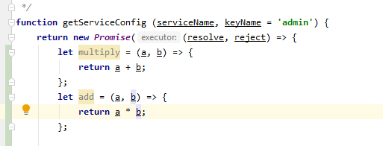
Bug Types: Logic Bugs
FOR INTERNAL USE ONLY
These are Errors that occur in code, where the code isn’t doing what’s expected
- Should be caught by code review and unit testing
- Can happen on production but should be caught and reported by users / business
Information classiﬁcation: Public

Slide 12
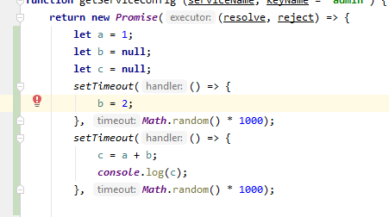
Bug Types: Race time Bugs
FOR INTERNAL USE ONLY
These are Errors that occur in runtime with typically async code, where the code isn’t handling the async nature of the code or a 3rd party
Should be caught by code review and unit testing
- Can happen on production but should be caught and reported by users / business, sometimes alerting if a runtime error occurs
- Hard to debug as they are intermittent by nature
Information classiﬁcation: Public

Slide 13
Bug Types: Integration Bugs
FOR INTERNAL USE ONLY
These are Errors that occur where the code isn’t handling a 3rd party correctly
Should be caught by code review and integration testing
- Can happen on production but should be caught and reported by users / business, sometimes alerting if a runtime error occurs
Hard to prod issues find in dev/test if not representative of prod
Hard to find in unit tests as they have assumptions about 3rd parties when properly mocked
Information classiﬁcation: Public

Slide 14
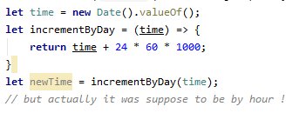
Bug Types: Requirements Bugs
FOR INTERNAL USE ONLY
These are Errors that occur when the code is working correctly but not doing the correct thing
Should be caught by code review or business testing
- Important that release items are retested before release in a test environment
- Due normally to poor communication or misunderstandings between people
Information classiﬁcation: Public

Slide 15
Bug Types
FOR INTERNAL USE ONLY
Bugs are hard
identify bug behaviour to discover type of bug
Type of bug will determine root cause
Type of bug will fix for bug
Type of bug will aid retrospective to prevent future types of that bug
Information classiﬁcation: Public

Slide 16
Questions ?
FOR INTERNAL USE ONLY
Information classiﬁcation: Public

Slide 17
When Bugs Bug
These are the common times bugs occur
During Local Development
Non-Prod Environments
After Prod Release on Prod Box

Slide 18
When Bugs Bug
Also for fun…. Non-deterministically
Long after Code Changes
After 3rd Party API Changes

Slide 19
When Bugs Bug: On Local
Local Runtime errors are:
Common in local
Rare in dev/test/prod
Normally due to inconsistent environments or developer error

Slide 20
When Bugs Bug: Pre-Production
Normal Errors in Non-Prod are a normal and common thing
Common in dev
Rare in test
Should be picked up by unit tests, business testing
* How normal / common will impact your productivity ☺

Slide 21
When Bugs Occur: Non-Prod Box
Prevention:
Pairing / Peer Code Reviews
Write unit tests to test new code
Business Testing new features in business review
Test out existing features in testing QA environment *
Carry out regular automatic system e2e testing in dev
* Called regression testing

Slide 22
When Bugs Bug: After Prod Release
These are called regression bugs, and are very high priority
Should be caught by business checkout
Test scripts should help caught these
Service impacting bugs should be immediately hotfixed
Minor or Non Service impacting bugs should be put onto the next sprint’s backlog

Slide 23
When Bugs Bug: After Prod Release
Prevention:
Do Code Freeze before production release, to aid code stability
Beta and A/B testing can help testing out code with sub set of users before main release
Release out of hours to reduce outage/risks
Carry out system e2e testing
Test new features in testing environment
Test out existing features in testing environment *
* Called regression testing

Slide 24
When Bugs Bug: Long after Prod Release
These are called production bugs, and are high priority
These often are low priority (or they would have been found sooner)
Should be put in backlog for prioritisation and fixing

Slide 25
When Bugs Bug: Long after Prod Release
Prevention:
Test new features in testing environment before releases
Test out existing features in testing environment * before releases
Have mature error reporting mechanism to catch issues early
* Called regression testing

Slide 26
When Bugs Bug: After 3rd Party API Change
These are 3rd Party / Vendor production bugs, and are high priority
These often not caught until production
Should be immediately hot fixed, as often cause immediate and ongoing outage

Slide 27
When Bugs Bug: After 3rd Party API Change
Prevention:
Contact 3rd parties vendors and obtain release / upgrade schedule
Carry out regular automatic system e2e testing
Hook out dev to dev, test to test for 3rd parties to catch bugs early*
* Can come with it’s own challeneg dealing with others often broken environments

Slide 28
When Bugs Bug: Cliffnotes
Prod Release Bugs are just non caught Dev/Test Bugs
Prod Release Bugs are a nightmare, avoid at all costs
Only Prod bugs “matter”*
Keep good vendor contact to prevent Integration issues
Regression Test to prevent going backwards
Feature Test to ensure going forwards
Most* bugs happen after releases
* “matter” Dev/Test only matter to your productivity ☺
* Most up until working on Live Persion and IBMCloud…

Slide 29
When Bugs Bug: Questions ?
.

Slide 30
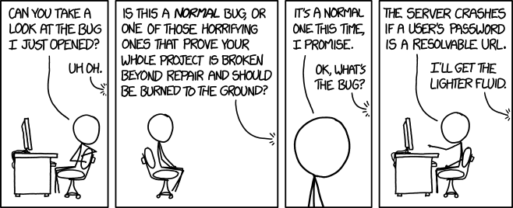
Bug Psychology
FOR INTERNAL USE ONLY
Serious Production Bug are actually hard to deal with.
Information classiﬁcation: Public

Slide 31
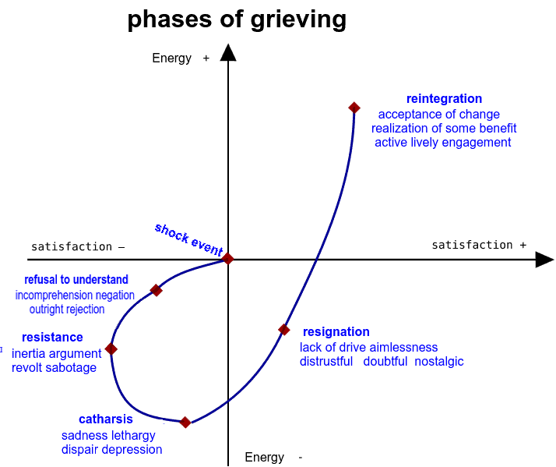
Bug Psychology
FOR INTERNAL USE ONLY
Apon finding a Bug, it can actually emerge as a Grief response
Information classiﬁcation: Public

Slide 32
Bug Psychology
FOR INTERNAL USE ONLY
Serious Production Bug are actually hard to deal with.
It’s important to not turtle up, or get overwhelmed at a team or personal mistake
2 basic rules to help you deal with the stress of bugs
Information classiﬁcation: Public

Slide 33
Bug Psychology: PROD INCIDENT EXAMPLE
FOR INTERNAL USE ONLY
Steps:
Discovery
Reproduce in Dev/Local
Fix in Dev/Local
Reproduce in Test
Fix In Test
Paperwork…
Reproduce in Prod
Fix in Prod
Information classiﬁcation: Public

Slide 34
Bug Psychology: REAL PROD INCIDENT
FOR INTERNAL USE ONLY
Discovery
Reproduce in Dev/Local
Having everyone and their boss emailing / phone you
Fix in Dev/Local
Having everyone and their boss emailing / phone you
Reproduce in Test
Having everyone and their boss emailing / phone you
Fix In Test
Having everyone and their boss emailing / phone you
Paperwork…
Having everyone and their boss emailing / phone you
Reproduce in Prod
Having everyone and their boss emailing / phone you
Fix in Prod
Having everyone and their boss emailing / phone you
Profit
Having everyone and their boss emailing / phone you
Steps:

Slide 35

Bug Psychology: REAL PROD INCIDENT
FOR INTERNAL USE ONLY
Steps in Music Form
.

Slide 36
Bug Psychology
FOR INTERNAL USE ONLY
2 basic rules to help you deal with the stress of bugs
Rule 1: DON’T PANIC * * maybe grab a towel
Information classiﬁcation: Public

Slide 37
Bug Psychology
FOR INTERNAL USE ONLY
2 basic rules to help you deal with the stress of bugs
Rule 1: DON’T PANIC * * maybe grab a towel
Rule 2: Communication & Honesty - Report Issues immediately - Don’t Hide / Ignore Issues - Don’t dismiss Error Reports (always reply to reports)
Information classiﬁcation: Public

Slide 38
How to Fix Bugs : Discovery
FOR INTERNAL USE ONLY
Cliffnotes AKA:
Rule 1: DON’T PANIC
Rule 2: Communication & Honest Report Issues immediately
Information classiﬁcation: Public

Slide 39
Questions ?
FOR INTERNAL USE ONLY
Hopefully this helps you guys, now onto puzzles
Information classiﬁcation: Public

Slide 40
Find that BUG
FOR INTERNAL USE ONLY
Information classiﬁcation: Public

Slide 41
Linting: All code is excellent
“Audience Participation” : Javascript is easy
“which lines return true ?”

Slide 42
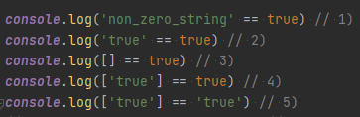
Linting: All code is excellent
“which lines return true ?”

Slide 43
Linting: All code is excellent
“which lines return true ?”

Slide 44
Linting: All code is excellent
“which lines return true ?”

Slide 45
Linting: All code is excellent
“which lines return true ?”

Slide 46
Linting: All code is excellent
“which lines return true ?”

Slide 47

Linting: All code is excellent
“which lines return true ?”
Obviously, the winner is :

Slide 48
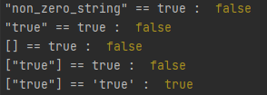
Linting: All code is excellent
WAT…

Slide 49
…
And that’s enough code
lets talk about puzzles

Slide 50
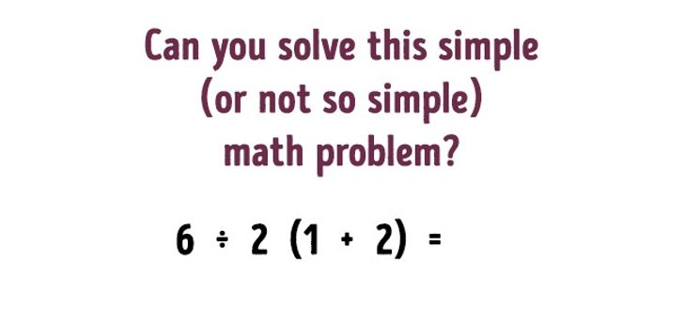

Slide 51
9
6 ÷ 2 х 3 = 9

Slide 52
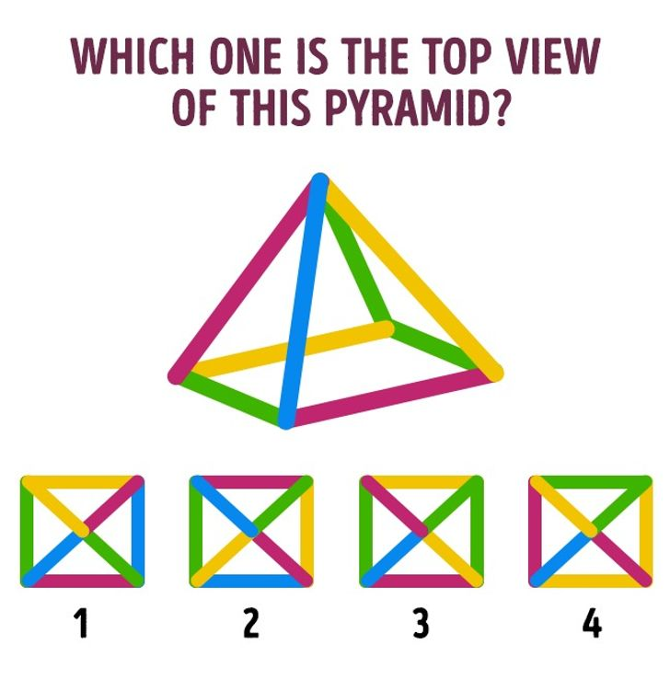

Slide 53
R, G, Y, B

Slide 54
…
Think Maths operators

Slide 55

? 9 = 3

Slide 56
…
Think Maths operators
+ - ÷ × √ ∑ ! %
? 9 = 3

Slide 57
√ 9 = 3

Slide 58



Slide 59
2nd
in 1st
in 2nd

Slide 60
…
Last find the operator one

Slide 61
3? = 6

Slide 62
…
Think Maths operators
+ - ÷ × √ ∑ ! %
3? = 6

Slide 63
3! = 3 x 2 x 1 = 6

Slide 64
…
One last one

Slide 65
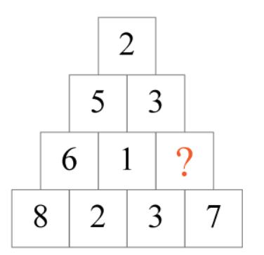

Slide 66
4

Slide 67
Questions
I’ve been Anthony “Zapper” M^{c}Kale
Hopefully I’ve Educated, Informed, and even Entertained Good Testing is Good Security is Good software

Slide 68
Thank you

